Slide 1
Ailment Divination
Using Artificial Intelligence and Machine Learning

Slide 2
Contents
Introduction
Literature Survey
Software Requirement Specification
System Design
Detailed Design
Testing and Implementation
Conclusion and Future Enhancements

Slide 3
Introduction

Slide 4
Introduction
AI & ML Based Ailment Divination is a system that uses user information at the time of registration to forecast sickness.
It also anticipates a patient's or user's disease based on the information or symptoms entered into the system and returns suitable findings.
It was over if the patient was not very ill and the user only needed to know the illness kind.
It's a tool that gives users advice and methods for keeping their health plan in check, as well as a means to get sick utilizing Divination.

Slide 5
Project Purpose
The purpose of making this project called “AI & ML Based Ailment Divination” is to predict the accurate Ailment of the patient using all their general informations and also the symptoms.
The basic goal of this illness categorization is to offer diagnosis for numerous and recurrent disorders that, if left untreated or neglected, can develop into a lethal condition that causes tremendous harm to the patient and their family members.
This system will predict the most possible Ailment based on the symptoms

Slide 6
Project Features
This is done based on the previous datasets of the hospitals so after comparing it can provide up to 80% of accurate results, and the project is still developing further to get the 100% accurate results.
With the help of Ailment Divination, it can predict the Ailment of the patient and can solve various problems and prevents from various aspects.
It provides security for the system so that no one can break into that and no one can make any changes in the system.
The Ailment is predicted using the algorithms and the user has to enter the symptoms from the given drop-down menu, in order to get correct accuracy, the user has to enter all the symptoms.

Slide 7
Literature Survey

Slide 8
Existing System
Traditional divination methods and models incorporate a number of risk variables, as well as a number of algorithms, such as databases, programmes, and many more.
High-risk and Low-risk patient classification is done on the basis of the tests that are done in group. But these models are only valuable in clinical situations and not in big industry sector.
Patients can’t take consultancy and appointments with doctors in-time
Patients can’t have suggestion for proper medication

Slide 9
Proposed System
The proposed AI & ML Based Ailment Divination system would employ a variety of methodologies, algorithms, and other tools to develop a patient-centered diagnostic system based on symptoms and comparing those symptoms to previously existing system data. We can estimate the correct percentage of the patient's sickness by combining those data sets and comparing them to the patient's condition
This system recognises the user's symptoms and predicts the disease based on the symptoms and previous databases, assisting in ongoing diagnostic tests for viral infections, heart rate, blood pressure, diabetes, and a variety of other internal and external symptoms, predicting appropriate and specific illnesses.

Slide 10
Tools and Technology
Python is used as Backend Functionalities Which requires some of the python packages like Scikit-learn, Psycopg2, Joblib.
Django Web Environment Using HTML, CSS and Javascript like NodeJS.
PostgreSQL (PGAdmin) for Storage of Database.

Slide 11
Software Requirement Specifications

Slide 12
Functional Requirement from User
Admin
Admin can view and modify (delete, update and Insert) all the Users or Patients who had their appointments with their respective doctors.
Admin can view the names of the doctors of their respective fields and can search for the specialists of the particular field.
Admin will approve the registration of the doctors based on their experience and knowledge by conducting the offline/Online Consultations.
Admin can approve/reject or delete the account of doctor request for the registration on the website.
Doctor
Doctors can view and edit their profile.
Doctors can view and Update the Schedules and Consulting hours to their patients.
Doctors can Approve or cancel the requests of the Booking or appointments.
Doctors will be notified on the arrival of the requests.
Doctors will receive the messages and chats from their patients and admins.

Slide 13
Functional Requirement from User
Patients/User
Patients can view and edit their profile.
Patients Or Users can divinate their ailment by inputting their symptoms occurred.
Patients can view the suggested doctors to their respective symptoms like Fever, Cough, Headache, Abdominal pain, Yellow-eye, Vomiting, Constipation, Loose-motion, Burning chest, Itching and so on.
Patients can view the suggested specialists, surgeons and doctors in the respective fields like Cardiologist, Gynocologist. Orthopedic, Dentist and so on.
Patients can book their appointments and view the status of their appointments.
Patients can consult to their doctors via message in the consultation hours.
Patients can view the profile and details of their doctors suggested.

Slide 14
System Design

Slide 15
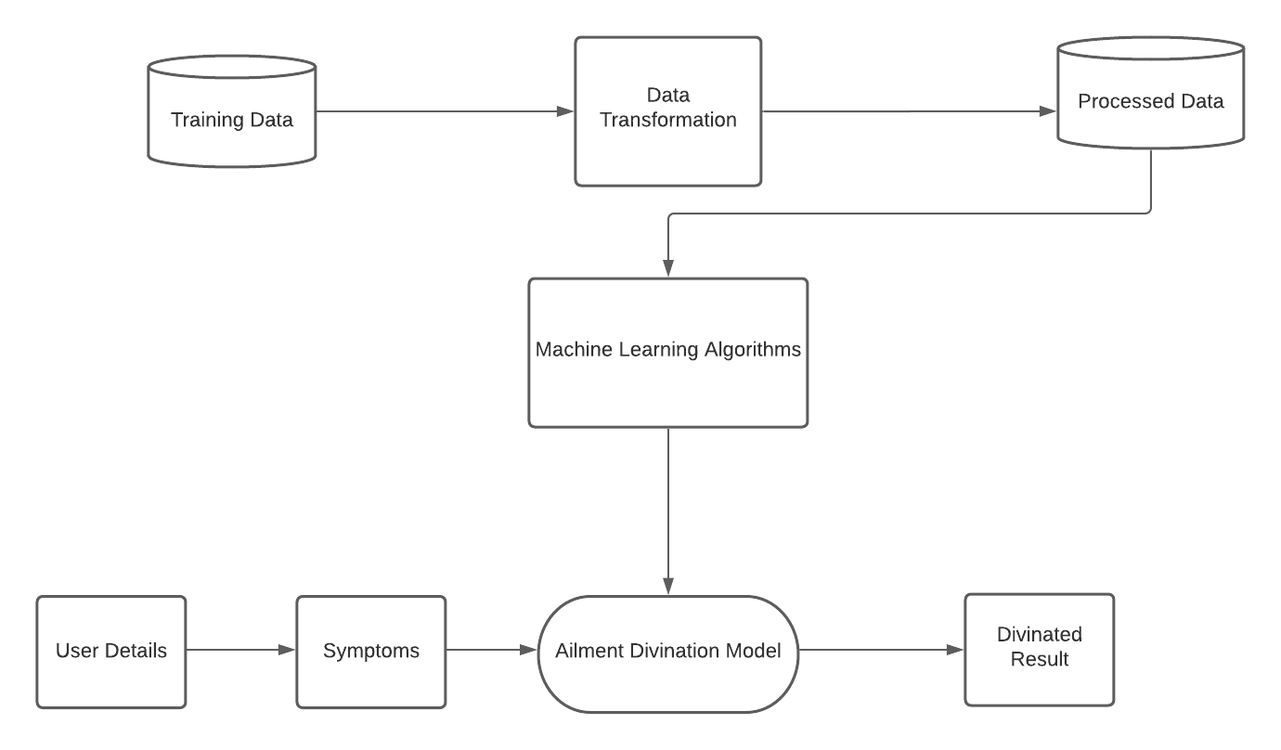
Architecture Diagram

Slide 16
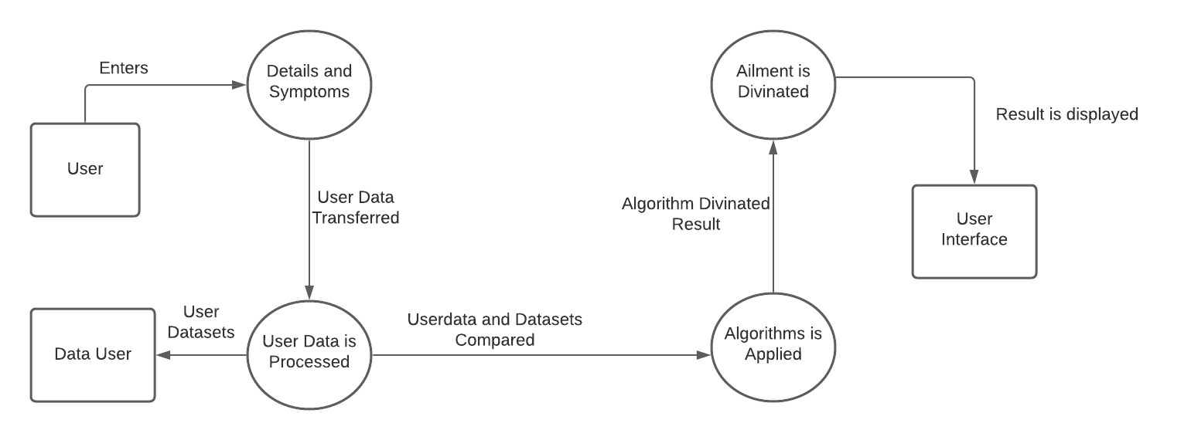
Dataflow Diagram

Slide 17
Detailed Design

Slide 18
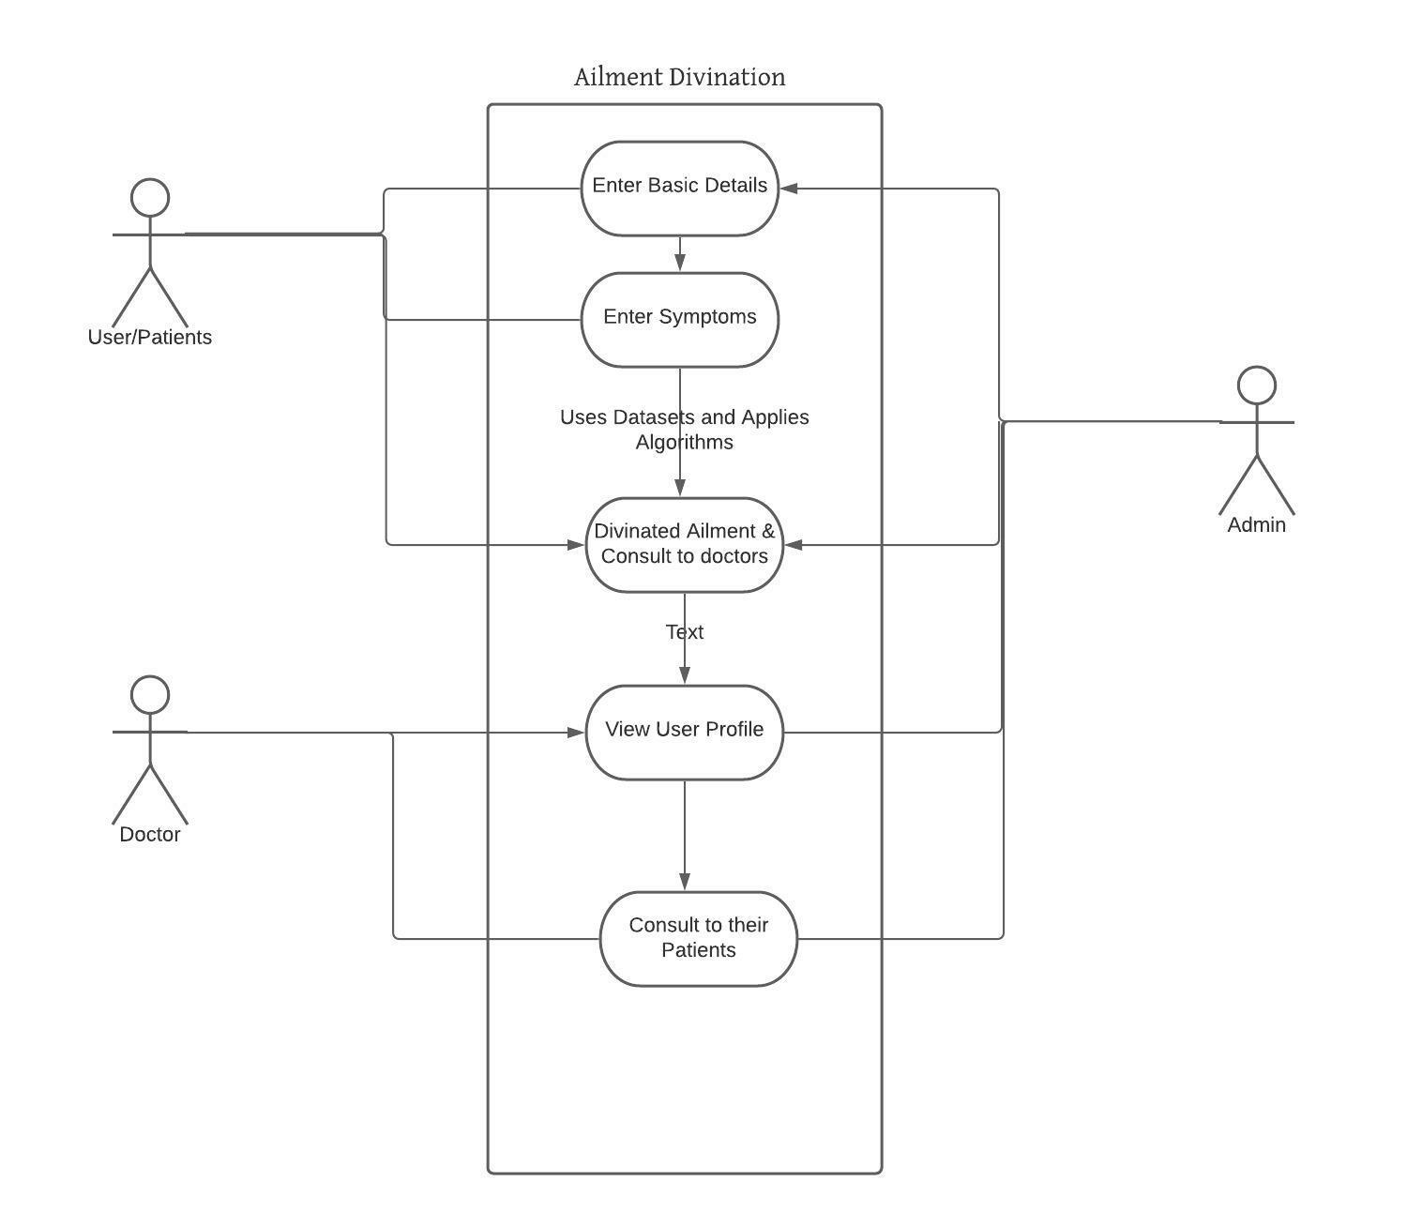
Use Case Diagram

Slide 19
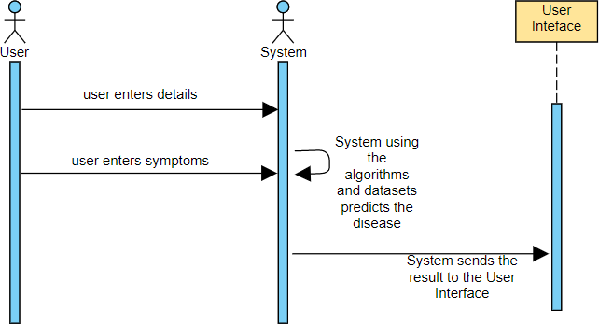
Sequence Diagram

Slide 20
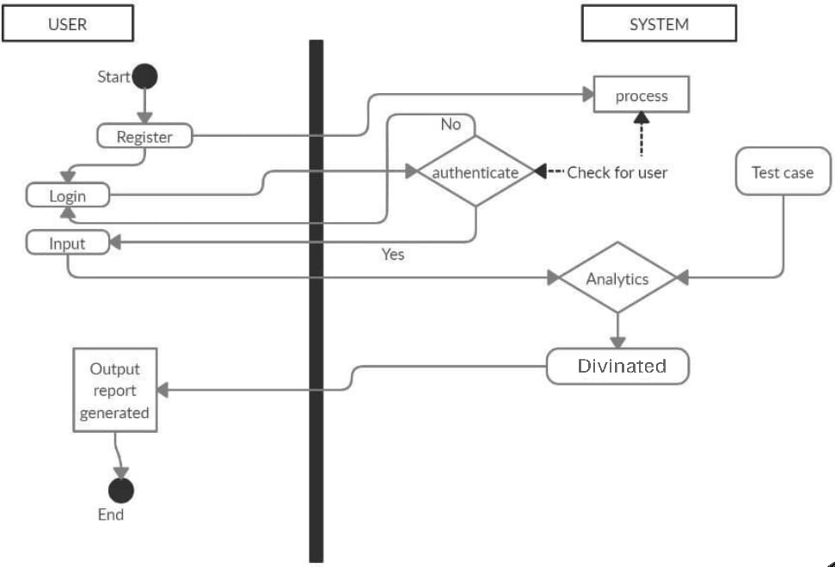
Activity Diagram

Slide 21
Testing and Implementation

Slide 22
Test Case for Divination of Result
Test Case No | Module Under Test Case | Description | Input | Output | Remarks
1 | Divination Result | User needs to enter symptoms | Name and Symptoms | If User enters all the five symptoms then accuracy will be high | Test Successful
2 | Divination Result | User needs to enter symptoms | Name and Symptoms | If User enters few symptoms then accuracy will be low | Test Failure

Slide 23
Test Case for Consultation
Test Case No | Module Under Test Case | Description | Input | Output | Remarks
3 | Consultation | User must divinate their Ailment and Go for Consultation | Divination Ailment | If User Consults the doctor based on Ailment then the accuracy will be high | Test Successful
4 | Consultation | User must divinate their Ailment and Go for Consultation | Divination Ailment | If User Consults the other doctor then the accuracy will be high | Test Failure

Slide 24
Future Enhancement & Conclusion

Slide 25
Future Enhancement
Today, the majority of data in the digital world is disseminated and misused. We can apply the existing data to unknown patterns by studying it.
The primary goal of this research is to develop a method for accurately predicting cardiac disease.
A logistic regression technique, Navie-bayes, and sklearn in machine learning can be used to predict cardiac disease. Paperwork for the detection of heart disease utilising improved procedures and algorithms for short-term difficulties is the scope of the future.

Slide 26
Conclusion
Nowadays, the healthcare industry plays an important role in treating patients' illnesses, so this is also a form of assistance in the healthcare industry to inform the user and also useful to the user in case he does not want to go to the hospital or other clinics, so by adding signs and other useful information, they are already in control, and the healthcare industry can benefit from the programme by simply implementing it.
By just asking the user for symptoms and entering into the system, they may determine directly and to a degree accurately what diseases they have in just a few seconds.
If the healthcare sector adopts this initiative, doctors will have less work to perform and will be able to anticipate a patient's condition more readily.
Divination is used to treat a variety of common diseases that, if left untreated, can develop into a fatal condition that can affect the sufferer and his or her family.

Slide 27
Thank You
MCA Department KLEIT, Hubballi

